Slide 1
Are We Creating an Informed Society?: Exploring the Information & Media Literacy Skills of New Brunswick Students
Presented by Courtney Pyrke

Slide 2
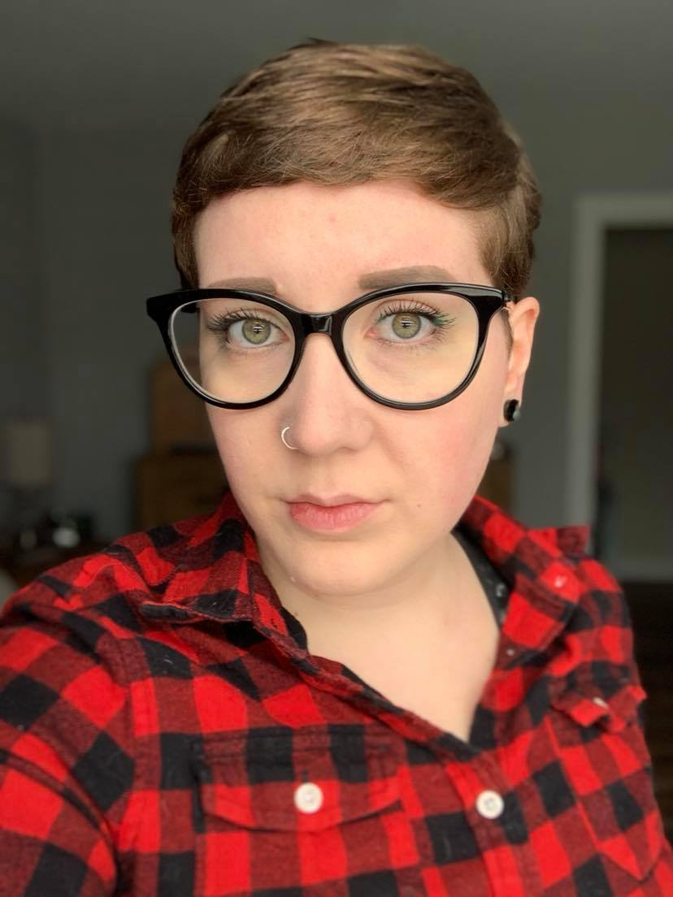
Hello!
I am Courtney (they/them)
Professional Librarian
UNB PhD Student in Interdisciplinary Studies
Notes:
My name is Courtney and I use they/them pronouns. I am a professional librarian, having graduated with my Master of Library and Information Science degree from Western University in 2015. Since graduating, I have worked in college, university, and public libraries. In my roles as a librarian, I largely helped people navigate and understand information. I am currently taking a hiatus from my field to focus full-time on a PhD. I am researching how students are being prepared to conduct research (ie. Information and Media Literacy Skills) during high school in New Brunswick. I am also looking at how the resulting level of preparedness for university level research impacts academic success and library/information related anxiety.

Slide 3
Why Do I Care About This?
Two main things I learned while working as a librarian:
Information is messy and confusing.
Many people lack basic information and media literacy (IML) skills.
As a result, misinformation is used as a weapon against our communities.
Notes:
Having worked with people from across the socioeconomic spectrum, in academic libraries and public libraries, a trend I saw in both environments was peoples lack of understanding and confidence in basic information & media literacy skills. At the academic level, I worked with medical students and health care professionals. I assumed, going into this job, that I was going to be completely out of my element. However, it was a very different experience as I quickly learned that these students, staff, and faculty members spend very little time in research databases and also do not specialize in the research process. They specialize in medicine and health care. So while they did have a better understanding of the language in their fields, they did not understand how to use that language when looking for specific articles.
In public librarianship, I found myself helping many patrons use our computers and navigate information online for accessing social services, such as housing or health care services. The challenging part for these patrons was their lack of experience with the technology, filling out online forms, finding the information online, and understanding the specific wording in government documents.
Through these experiences, I started to become increasingly interested in information literacy and how/when people learn this skill set in New Brunswick. As we have seen in the news and online, misinformation is used as a weapon against our communities. So, how are we addressing this in our province?
*Messy & confusing → standardized language across all research databases does not exist.

Slide 4
Information literacy is a set of abilities requiring individuals to recognize when information is needed and have the ability to locate, evaluate, and use effectively the needed information. - American Library Association
Notes:
The phrase "information literacy" first appeared in print in a 1974 report written on behalf of the National Commission on Libraries and Information Science by Paul G. Zurkowski, who was at the time president of the Software and Information Industry Association.
Some scholars defines the term as a human rights issue: "Information literacy empowers people in all walks of life to seek, evaluate, use and create information effectively to achieve their personal, social, occupational and educational goals. It is a basic human right in a digital world and promotes social inclusion in all nations.”
An example of IL might be knowing to read hotel reviews online
Or
Researching an author of a controversial research paper.

Slide 5
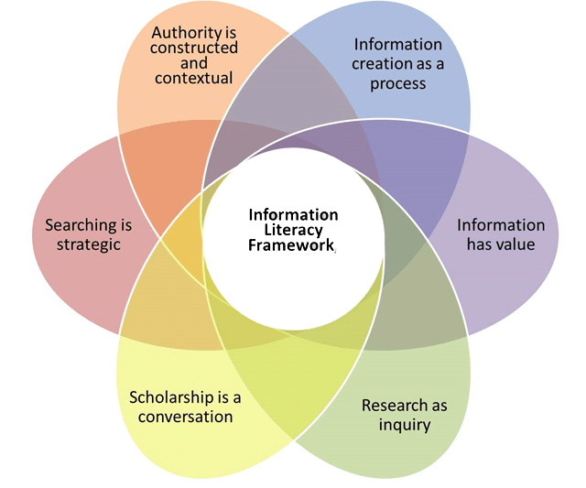
Notes:
Information Literacy Framework:
The ACRL Framework for Information Literacy for Higher Education was preceded by the association's Information Literacy Competency Standards for Higher Education. It exists as a model for librarians to follow in teaching students about research and evaluation of information. Canada has not developed a national IML strategy which would support IML skill development in K-12 and post-secondary education, as well as prepare students for on-the-job training (Media Smarts, 2010). Where does this leave grade school students?
UNB has roughly 30 librarians spread across 5 UNB library buildings
Since at least 2005, only 11.7% of school in New Brunswick had teacher-librarians or library assistants (neither positions are trained librarians).
http://www.ala.org/acrl/standards/ilframework

Slide 6
What Does This Mean for Grade Schools?
Librarians are not teaching students Information & Media Literacy skills in New Brunswick.
Notes:
Scholars have reported that while classroom teachers play a pivotal role in a child’s development, school librarians are the only information literacy experts, and often the only staff member with education, expertise, and time to ensure that students are receiving a comprehensive education in information literacy (Berg, Malvey, & Donohue, 2018). School librarians play a critical role in the public education system for both students and educators; socially and economically strengthening our democratic society. Most notably, among a variety of benefits, the use of school librarians results in: higher standardized test scores; higher graduation rates; stronger information, media, and digital literacy skills; enhanced skills in critical thinking, problem solving, and communication; improved literacy rates and reading engagement; post secondary and career readiness (PSCR).
In New Brunswick, students continue to score below the overall Canadian average in literacy and reading (Councils of Ministers of Education Canada – CMEC, 2018). If students continue to graduate with low information literacy skills, society will continue to see the rise of misinformation campaigns such as the alt-right and anti-vaccination movements (Gretter, 2017).
While there has been extensive research on the impact of school libraries and school librarians in the United States (Andrews & Hilarie, 2017; Berg, Malvey, & Donohue, 2018; Copeland & Jacobs, 2017; Gregory, 2018), there has been minimal research conducted on this topic in Canada. Additionally, there has been minimal research conducted that explores the state of school libraries and librarians in Canada, specifically in the Province of New Brunswick.

Slide 7
7,804 student responses
80% of middle school
80% of high school
from US 2016 study….
students believe that web ads were real news stories and…
students had a hard time distinguishing between real and fake photos.
Notes:
In a 2016 study, results demonstrated that out of 7,804 student responses, 80% of middle school students believe that web ads were real news stories, and 80% of high school students have a hard time distinguishing between real and fake photos (Gretter, 2017, p. 21).

Slide 8
only 28%
From a sample of 543 first-year post-secondary students in the United States are prepared to complete a college or university level research project.
Notes:
Based on Library Journal’s 2017 study, only 28% of a sample of 543 first-year post-secondary students in the United States are prepared to complete a college or university level research project (Library Journal, 2017).

Slide 9
PhD Research Study
Notes:
Mixed methods research study – two main components to my research study
This research will aim to answer the research question: how are students being prepared to conduct research (i.e. Information and Media Literacy) during high school education in New Brunswick and how does the resulting level of preparedness for university level research impact academic success and mental health (library and information anxiety)? The primary objective of this research project is to examine the relationship between IML, mental health and attrition in first year university students at the University of New Brunswick (UNB).

Slide 10
Library Anxiety is the feeling that one’s research skills are inadequate and that those shortcomings should be hidden. In some students this manifests as an outright fear of libraries and the librarians who work there. -Constance A. Mellon
Notes:
Mellon's landmark two-year qualitative research study, which included 6,000 students at a Southern university in the United States, found that 75 to 85 percent described their initial response to library research in terms of fear. Mellon used the term "library anxiety" to describe the feelings of discomfort and fear a group of undergraduate English composition students described when they were starting an information search that required using the academic library. The study revealed four primary reasons to explain feelings of library anxiety. The students:
were intimidated by the size of the library,
lacked knowledge about where everything was located,
lacked knowledge about how to begin the research process, and
lacked knowledge about what to do.

Slide 11
Mixed Methods Research
Qualitative – Ethnographic Study
Quantitative – Survey & Analysis
Curriculum Review - Coding
I will observe how high school students, my participant sample, from 7 ASD-S schools use the high school library spaces (including learning commons) and library resources (physical and digital)
A cross-sectional, pre-post electronic survey of first year students over two years of their studies at UNB (4 semesters) starting at the beginning of their first semester.
Content analysis of the high school curriculum in New Brunswick to examine the degree of integration of IML concepts.
1
2
3
Notes:
Primary purpose of the qualitative aspect of my study is to formally examine New Brunswick high school library spaces and their resources and how they are used by high school students and teachers.
An ethnographic study will be conducted at seven ASD-S high schools. These schools will be chosen as the initial sample because the majority of UNB Saint John's student population comes from these schools.
I will be observing how high school students use the high school library spaces (including learning commons) and library resources (physical and digital). The intention of this ethnographic study is to determine if students’ have the resources available to them to conduct research coinciding with the curriculum. The purpose of observing how the high school library spaces and library resources are used is to gain a better understanding of the relationship between curricular expectations of high school students, their educational infrastructure, and their actual information seeking behaviours when starting university. I will then be interviewing high school teachers from the listed high schools to obtain a better understanding of how teachers incorporate these spaces and resources into their everyday teaching.
Data and information from the library space observations will be collected/recorded in the form of field notes (electronic) and observational protocols. Each library space will be observed for one full school week (Monday to Friday). I will also be collecting an inventory of the library space/resources at each school. To protect the identities of my vulnerable participant sample (high school students), there will be no video or audio recordings collected. Data and information from teacher interviews will be collected in the form of audio recordings and complimentary field notes. This ethnographic/observation research does not ask participants for their names or any other identifying information. The only information I will be collecting is the name of the school the data was collected from.
It is expected that the primary outcome at this stage of the research will be providing preliminary exploratory investigations that will lay the groundwork for further research I will conduct during my dissertation project. The observations and teacher interview results will inform me of how students and teachers are utilizing their library spaces and library resources. Finally, the results of this ethnographic study will be paired with other quantitative datasets in order to provide them additional demographic stratification or context
****************************
A cross-sectional, pre-post electronic survey of first year students over two years of their studies at UNB (4 semesters) starting at the beginning of their first semester. This survey will measure their IML skills, their mental health symptomology (library and information anxiety), and their most recent grades. The first survey will ask students to report their grade point average from their last semester of high school and the other surveys will ask for their grade point average from their current semester.
A sample of roughly 400 research participants will be derived from UNB (exact target sample size will be determined by a power analysis). The sample will be comprised of domestic and international students entering their first year of studies who have a valid high school diploma (this includes students who completed their GED or were home schooled). These students will be cross-sectionally surveyed as they enter their studies (September) and after their second year of studies is completed.
The following will be measured using the online survey:
Students’ IML competency using a questionnaire comprised of subjective measures of perceived self efficacy in IML and quantitative IML scales;
Mental Health symptomology using standardized questionnaires such as CESD-R, the Kessler 6, and surveys that evaluate information/library anxiety;
Self-reports of students’ grade point averages throughout their two years of study; and
Demographic information including the high school they attended, gender, age, and socioeconomic status.
The analysis of the survey results will begin with descriptive and bivariate analyses. These will be performed to assess relationships between IML, mental health, and academic success. Following this, regression analyses of the survey data will be used to identify statistically significant predictors of academic success and/or mental health symptomatology within the study sample.
Demographic variables such as high school attended, age, gender, etc. will be controlled for throughout these analyses. I will write two papers with this data, the first being a paper on the relationship between students’ mental health (library and information anxiety) and attrition at UNB. The second paper will focus on UNB’s UNIV1003 course as an intervention. I will examine whether this course is reducing students’ library and information anxiety and improving IML skills, compared with students who do not take this course.
****************************
The third component of this research is a content analysis of the high school curriculum in New Brunswick to examine the degree of integration of IML concepts. As English is a mandatory subject for all high school students, the English subject curriculum (retrieved from the Government of New Brunswick website) will be examined and coded to identify instances of IML language or concepts. Themes will be derived from the coded curriculum to understand the number and quality of references to IML in order to make inferences about high school graduates’ expected IML competency. I will also research the history of school libraries in New Brunswick’s public education system. With this information, I will write a third paper about the coded results and the history of school libraries in New Brunswick.

Slide 12
Future Plans…
Start Research
Summer of 2021, after completing Comprehensive Exams.
Work with GNB
To share research and improve education system.
Publish and expand
Wanting to perform this research in other provinces across Canada.

Slide 13
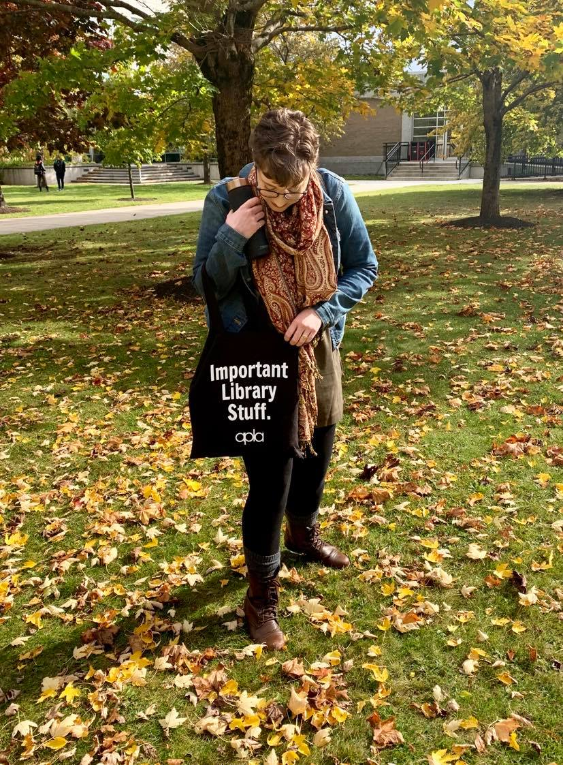
Thanks!
Any questions?
You can find me at:
@courtums
Courtney.Pyrke@unb.ca

Slide 14
References
American Association of School Librarians. (2006, September 27). About AASL [Web Page]. Retrieved from: http://www.ala.org/aasl/about.
Association of College and Research Libraries. (February 9, 2015). Framework for information literacy for higher education [Web Page]. Retrieved from: http://www.ala.org/acrl/standards/ilframework.
Andrews, C. R., & Hilaire, D. S. (2017). Aligning the curriculums for college success: high school and college library collaborations. Community & Junior College Libraries, 23(1–2), 41–62. https://doi.org/10.1080/02763915.2018.1558900
Berg, C., Malvey, D., & Donohue, M. (2018). Without foundations, we can’t build: information literacy and the need for strong school library programs. In the Library with the Lead Pipe. Retrieved from: http://www.inthelibrarywiththeleadpipe.org/2018/strong-school- library-programs/.
Copeland, A., & Jacobs, L. (2017). The power of collaboration between school librarian and classroom teacher. Teacher Librarian, 45(2), 22–27.
Gretter, S., Yadav, A., & Gleason, B. (2017). Walking the Line between Reality and Fiction in Online Spaces: Understanding the Effects of Narrative Transportation. Journal of Media Literacy Education, 9(1), 1-22. https://doi.org/10.23860/JMLE-2017-9-1-2
Gregory, J. (2018). The Information Literate Student: Embedding Information Literacy across Disciplines with Guided Inquiry. Teacher Librarian, 45(5), 27–34.
Library Journal (2017). First year experience survey: information literacy in higher education [PDF File]. Retrieved from: https://s3.amazonaws.com/WebVault/research/LJ_FirstYearExperienceSurvey_Mar2017.pdf.

